Slide 2
iCare Technical Overview
Dan Hallam
Reporting and Analytics, Hospitality Global Business Unit
July 27, 2015

Slide 3
Note: The speaker notes for this slide include instructions for when to use Safe Harbor Statement slides.
Tip! Remember to remove this text box.
Notes:
This is a Safe Harbor Front slide, one of two Safe Harbor Statement slides included in this template.
One of the Safe Harbor slides must be used if your presentation covers material affected by Oracle’s Revenue Recognition Policy
To learn more about this policy, e-mail: Revrec-americasiebc_us@oracle.com
For internal communication, Safe Harbor Statements are not required. However, there is an applicable disclaimer (Exhibit E) that should be used, found in the Oracle Revenue Recognition Policy for Future Product Communications. Copy and paste this link into a web browser, to find out more information.
http://my.oracle.com/site/fin/gfo/GlobalProcesses/cnt452504.pdf
For all external communications such as press release, roadmaps, PowerPoint presentations, Safe Harbor Statements are required. You can refer to the link mentioned above to find out additional information/disclaimers required depending on your audience.

Slide 4
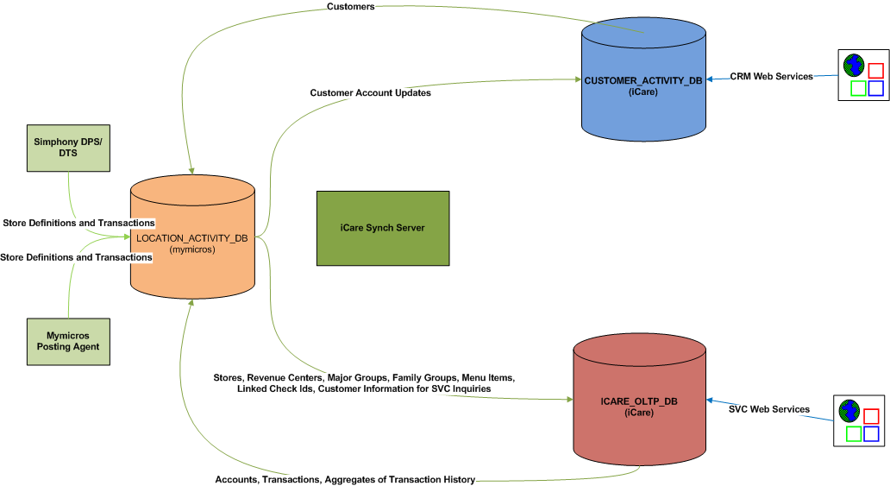
Overall Architecture

Slide 5
iCare_OLTP_DB
OLTP database handles account based transactions from RTA/SVC, Simphony Extensibility, Verifone, and custom clients
Definitions
Programs
Rules
Coupons
Account Activity
Accounts
Transactions
Coupon Account Distribution

Slide 6
Customer_Activity_DB
CRM database handles customer based web transactions from Simphony Extensibility and custom clients
Definitions
Customer Attribute Set
Campaigns
Offers
Promotions
Customer Activity
Customer
Transactions
Customer Attribute Values
Customer Promotion Response

Slide 7
Location_Activity_DB
mymicros Data Warehouse – Populated by mymicros and Simphony posting with enterprise definitions and activity
Definitions
Locations
Revenue Centers
Major Groups
Family Groups
Menu Items
Activity
Check Headers
Check Detail

Slide 8
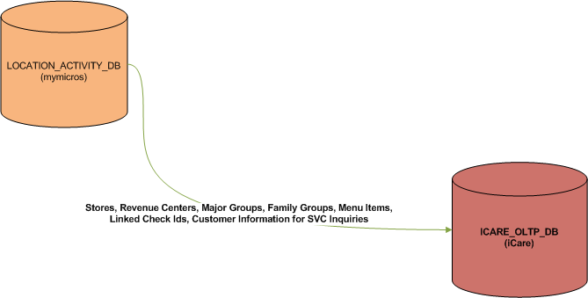
Data Flow (Location_Activity_DB to iCare_OLTP_DB)

Slide 9
Location_Activity_DB => iCare_OLTP_DB
Organization Configuration
Used for OLTP access to organization definition and structure when required
Inherits location web service login information from the RTA database in mymicros
Enterprise Definitions (Major and Family groups, Menu Items, Revenue Centers)
Definitions are used with Eligibility Item Rules to determine whether a transaction can be applied to a check and what portion of the check the transaction will be based on
Applies to Loyalty Points issue, Awards, and Redemption
Guest Check Information
The corresponding primary key value from Location_Activity_DB is populated into iCare_Account_Transaction via separate sync process
Allows trace of checks to iCare transactions and transactions to checks
Customer Information (name, phone #, address, birthday, postalCode)
Allows iCare accounts to be inquired by SVC using name, phone #, email address, etc

Slide 10
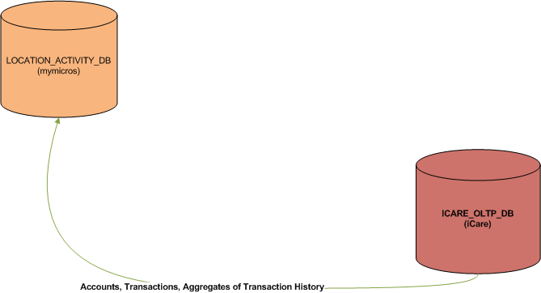
Data Flow (iCare_OLTP_DB to Location_Activity_DB)

Slide 11
iCare_OLTP_DB => Location_Activity_DB
Account Information (Expiration, Transfer, Lifetime balances, Program)
Synced from Account to Customer in mymicros
Transactions
Links to customer record in mymicros
Allows access in mymicros to checks with iCare transactions
Aggregates (For use in top level reporting)
Coupon activity – redemption, issuance, expiration – by business date/issuing location/redemption location
Liability – stored value liability by reconcile location/business date
Loyalty – Loyalty program activity by location/business date
Partner Activity – Aggregates of activity linking to an iCare partner program for use in partner liability reporting
Program Account – Aggregates of activity by Program
Stored Value Activity – Aggregates of all activity within Stored Value programs

Slide 12
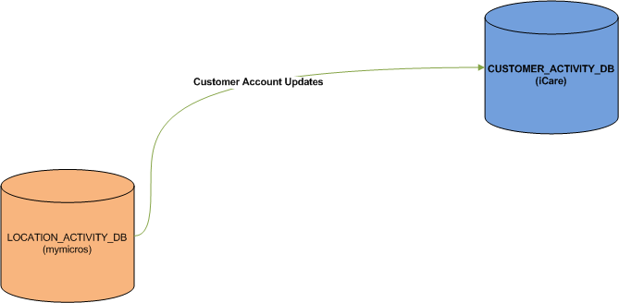
Data Flow (Location_Activity_DB to Customer_Activity_DB)

Slide 13
Location_Activity_DB => Customer_Activity_DB
Synced from Customer in mymicros to CA_Customer
Expiration
Transfer
Lifetime balances
Program
First and last transaction dates

Slide 14
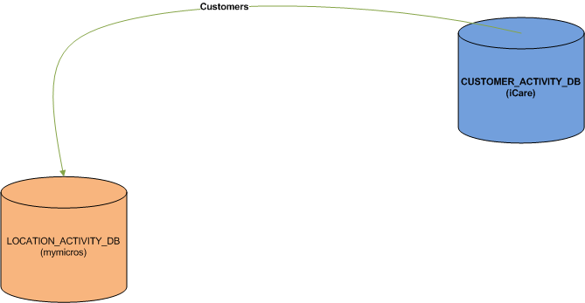
Data Flow (Customer_Activity_DB to Location_Activity_DB)

Slide 15
Customer_Activity_DB => Location_Activity_DB
Customer Information such as Name, Address, Phone Numbers, Birthday and Signup Date are synced
Information is supplied both for reporting and to be synced to the iCare_OLTP_DB for OLTP required fields

Slide 16
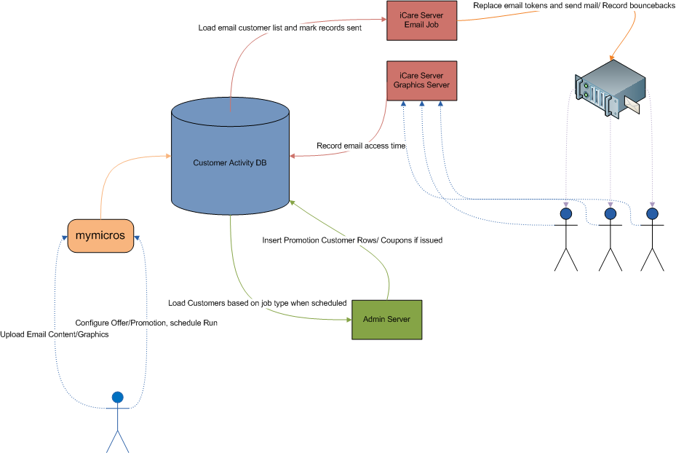
Campaigning – Legacy Email Campaigning

Slide 17
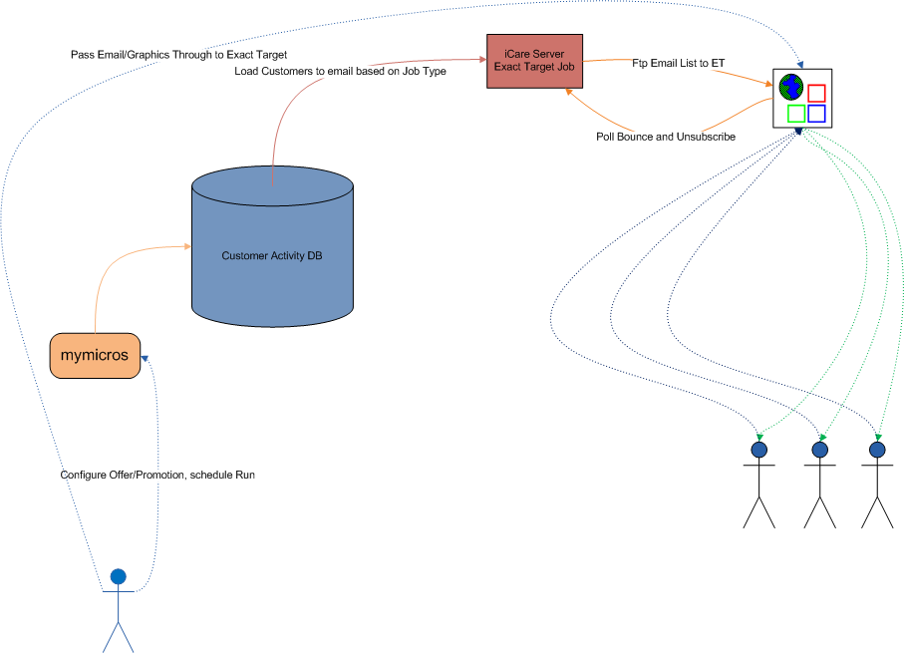
Campaigning – Exact Target Email

Slide 18
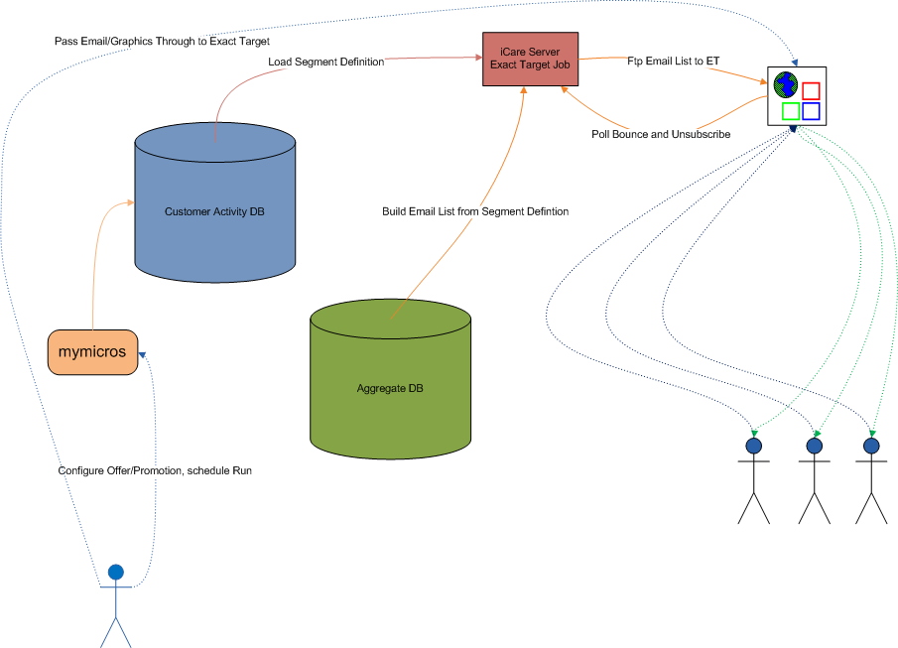
Campaigning – Exact Target Email with Segmentation

Slide 19
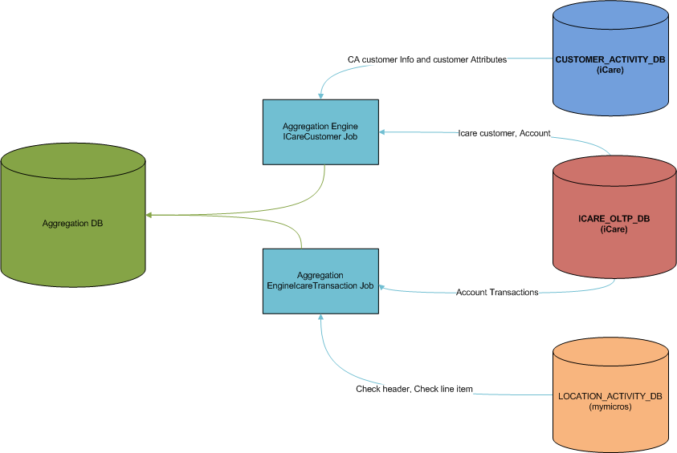
Segmentation – Population of Data

Slide 20
Segmentation - Populate Data to Aggregate DB once per day
Customer core info
Custom Attributes
Account Program information
Transaction record from iCare OLTP DB
Check header from mymicros
Check detail from mymicros

Slide 21
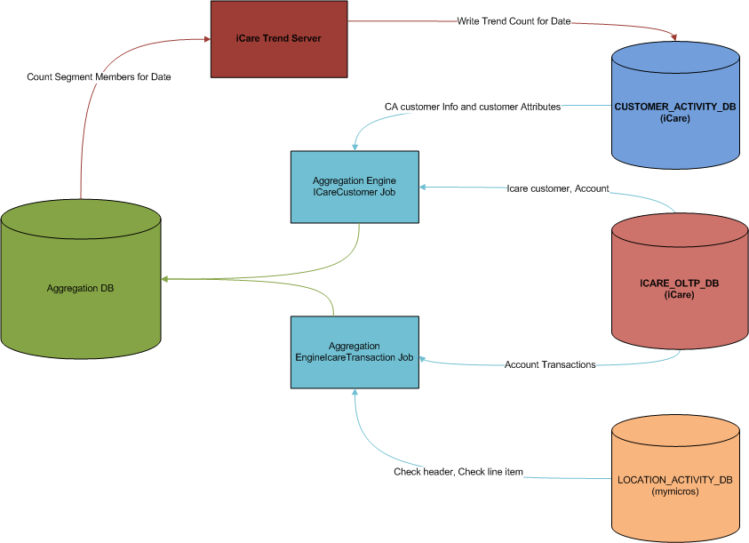
Segmentation – Trending of Data

Slide 22
Segmentation – Trending of Data
Trend count is built based on user defined customer segment
Segment size per iteration of trend is stored in Customer Activity DB
Trend is run daily, weekly, or monthly based on user configuration

Slide 23
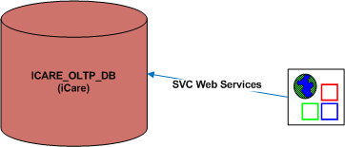
External – SVC Interface
Entry point for POS based transactions
Coordinated with SVC client used with 3700, e7, and 9700
works with Verifone pinpads
Accessible from custom clients

Slide 24
SVC Web Service Methods
Issue
Activate
Redemption Auth
Redemption
Reload
Balance Inquiry
Balance Transfer
Cash Out
Coupon Inquiry
Point Balance
Point Redemption
Point Issue
Accept Coupon
Alt Accept Coupon (Allows custom identifier)
Issue Coupon
Unique Item Inquiry

Slide 25
SVC Web Service Interaction
The SVC web service will provide instructions to the client to guide behavior
Can return an Action indicating the next message that should be sent after processing this return
Can return a list of Actions to allow the POS user to make a selection
Some examples of Action returns would be a selection of customers after a Last Name Inquiry or Coupon Redemption after Point Issue

Slide 26
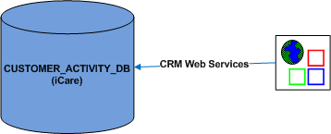
External – CRM Interface
Entry point for customer management transactions
Intended for use with custom implementations
Professional Services consultation is available for creating custom clients

Slide 27
CRM Web Service Methods
Set Customer
Get Customer
Set Contact Rule
Get Contact Rule
Get Customer PosRef
Set Customer PosRef
Get Offer
Get Column List
Get Customer Action Log
Set Customer Action Log
Post Customer Offer
Get Account
Set Account Tier
Get Account Partner
Get Account Transaction
Set Account Transaction

Slide 28
CRM Web Service Methods (Cont’d)
Get Partner
Get Program
Set Program
Get Program Tiers
Get Customer Program
Set Customer Program
Get Redemption Merchandise
Set Redemption Merchandise
Get Location
Get SM Application User
Set SM Application User
Get Coupons
Get Alt Coupons
Get Site Params
Set Site Params

Slide 29
Custom Web Services
iCare supports custom message implementations
Require an extending class and an entry in the web service map
Currently used to support Starbucks International – Provides a single point of pass through to Value Link that meets the secure VPN requirements without requiring a secure VPN link at every store

Slide 30
myIcard.net
iCare provides an end customer facing web page
This page may be rebranded with customer graphics
Page can be accessed using Card Number or Card Number with PIN
Provides the end customer with balance information, account history, and unique item purchases for relevant programs
Provides a customizable interface for updating customer information
Interacts with iCare through its own set of local web services

Slide 31
Administration & Reporting
Administration
Configuration and account management are performed in the mymicros portal
There are several portlets with configurable permissions by mymicros role to allow access to the desired set of functionality for different users
mymicros interacts with iCare both via web services and direct database access
Reporting
Both iCare databases are available as data sources in the mymicros Portal
myInsight reporting
iQuery Microsoft Excel plugin
iCare Account Administration Portlet
Segmentation Porlet

Slide 32
Technology Stack of mymicros

Slide 33
Environment and Development Tools
JBOSS 5.1
Apache Tomcat
JDK 1.6
SQL Server 2005+
ORACLE 10g+ (optional – Aggregate_DB and Location_Activity_DB only)
Eclipse
VSS => SVN
PVCS Tracker => Target Process

Slide 34
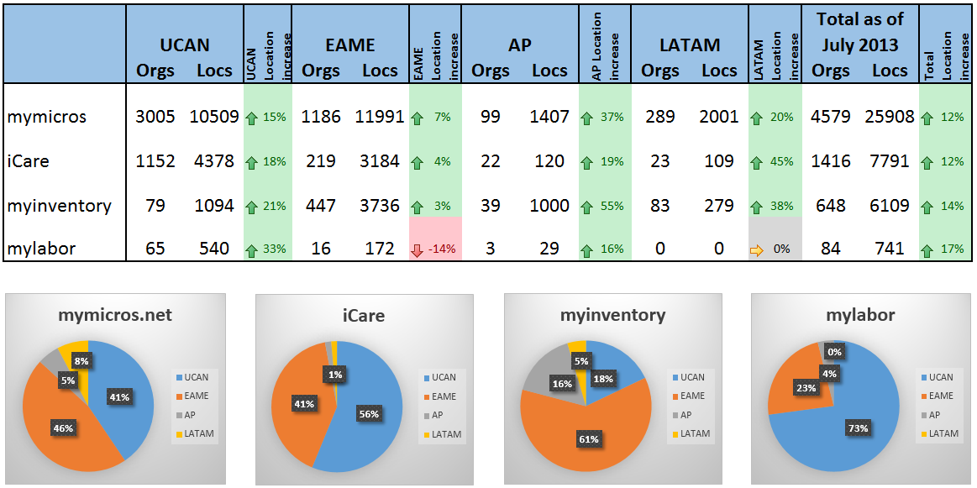
Hosted Customer Implementations

Slide 35
U. S. Hosting iCare Transactions Per Day (Average SVC Transactions)
PROD1 – 96,000
PROD2 – 15,000
PROD3 – 29,500
PROD4 – 2,000
PROD5 – 13,000
Carlson – 19,000

Slide 36
Strengths
Extremely versatile program implementation available to configure almost any style of loyalty program desired
Link with mymicros allows tracking of every aspect of a customer’s interaction with a corporation
Web API is versatile enough to support almost any customer implementation
Integrated strongly with micros POS

Slide 37
Areas for Improvement
mymicros UI needs to be updated – this includes iCare administration portlets and the myiCard page. Very outdated appearance.
Some older technologies to replace in mymicros and iCare such as Struts, older JBoss implementation and older Java
Program configurations can be very complex and non intuitive. The UI takes an object oriented approach that will not be obvious to non engineers
Additional tools are needed to analyze and review customer and transaction information

